Slide 1
Arteriovenous Nicking
Name
Institution
Course
Instructor
Date

Slide 2
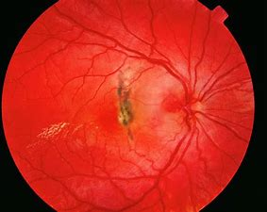
Arteriovenous nicking
(Introduction)
A condition that occurs with hypertensive retinopathy
Retina is damaged by high blood pressure
The condition may lead to severe cardiac problems
Ophthalmological examination necessitates the manifestation of signs
Notes:
Arteriovenous nicking is an eye condition that closely occurs with hypertensive retinopathy. Patients experiencing arteriovenous nicking undergo retinal damage resulting from extremely high blood pressure. Failure to address this condition with serious attention may lead to severe cardiac problems resulting from persistent hypertension. The fact that the venue and arteriole share a sheath means that the thick walls of the arteries push the venules leading to their collapse. Through ophthalmological examination, it is possible to tell the signs of arteriovenous nicking. The signs are also known as the Gunn sign. For evaluation and record purposes, pictures ought to be taken by a healthcare professional (Wang & Zhou, 2020).

Slide 3
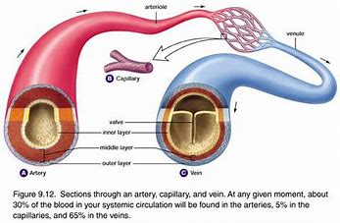
Introduction
The thick walls of arteriole compress the venules and result to increase in blood pressure
The eye becomes hypertensive
The hypertension results from compression
Notes:
Arteriole has thick walls. Upon crossing the venule with these thick walls, they compress the venules and lead to a rise in blood pressure on both sides of the venue. This leads to the eye having hypertension. The compression of the vein leads hinders the flow of blood in the veins and makes them bulge out. Resulting hypertension may damage arterioles in other body organs such as the brain, kidney, and heart. The most common cause of arteriovenous nicking is chronic hypertension (Wang & Zhou, 2020).

Slide 4
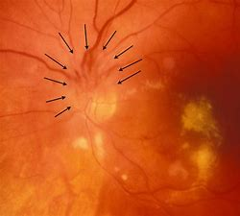
Pathophysiology of Arteriovenous Nicking
Leads to;
  reversible reorganization of blood vessels in the retina
  Optic disk edema
  Exudative vascular alteration
  Retinal complications
Notes:
Elevation of acute hypertension leads to reversible reorganization of blood vessels in the retina. Hypertensive disasters may lead to optic disk edema. Severe or more prolonged arteriovenous nicking results in exudative vascular alteration. This is an effect of endothelial necrosis and damage. Smoking accentuates the adverse effects of arteriovenous nicking. Arteriovenous nicking is a significant factor in other retinal complications such as diabetic retinopathy, vein occlusion, or retinal artery. Additionally, a combination of diabetes with arteriovenous nicking com exposes someone to the risk of losing vision. Patients suffering from arteriovenous nicking are exposed to higher risks of damaging other organs of their bodies (Lo et al., 2020).

Slide 5

Clinical Manifestations of Arteriovenous Nicking
Bleeding
continuous loss of neurological function
Nausea
Vomiting
Headache
Loss of consciousness
Seizures
Notes:
The physical changes of a body that result from arteriovenous nicking vary with the location of the condition. The appearance of the first signs and symptoms is observed after the occurrence of bleeding. Other signs and symptoms accompanying bleeding include continuous loss of neurological function, nausea, vomiting, headache, loss of consciousness, and seizures. Other signs and symptoms attached to this condition include back pain, memory loss or dementia, speech problems, problems in planning tasks, dizziness, confusion, and hallucinations. The occurrence of this condition among children may lead to problems associated with learning. In general, the signs and symptoms that demand medical attention are seizures, vision problems, dizziness, and headaches (Kriplani et al., 2020).

Slide 6
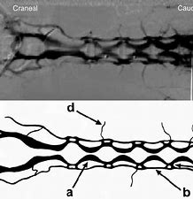
Causes of Arteriovenous Nicking
Compression of the venules
Glial Proliferation of cells
Sclerotic thickening of the venue
Notes:
The most common cause of arteriovenous nicking is hypertensive retinopathy. Research shows that arterioles and venules have a common sheath that they share. The outer walls of the arterioles are thicker than venules. For this reason, they compress the venule after crossing. When compressed, the venule is distorted into an hourglass shape. Some scientists believe that arteriovenous nicking does not result from compression of the venule. They claim that it results from the glial proliferation of cells at the site where arteriole and venule crosses and sclerotic thickening of the venue. These are the known leading causes of arteriovenous nicking for now (Lo et al., 2020).

Slide 7
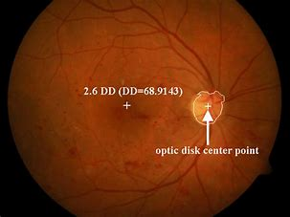
How to Detect Arteriovenous Nicking
Qualitative and subjective evaluation
Use of color fundus Image
Notes:
The assessment of arteriovenous nicking is a crucial indicator of cerebrovascular and cardiovascular diseases. Currently, ophthalmologists have conducted the evaluation using the qualitative and subjective manner in detecting whether the condition is present or absent. For this reason, a new method is proposed for the assessment of arteriovenous nicking. The use of color fundus serves this purpose well. It involves dividing blood vessels into parts using a multiscale line indicator. This is followed by detecting and classifying arteriovenous points to determine whether arteriovenous is present or absent. This approach is appropriate for separating typical cases from severe cases (Ilakkiya & Devi, 2020).

Slide 8
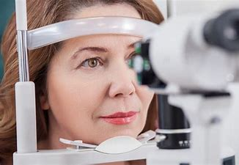
How to Detect Arteriovenous Nicking
Eye examination
Magnification lens are used for efficient results
Notes:
Another way arteriovenous nicking can be detected is through examining an eye. This is done by use f bright light that is directed towards the pupil to observe the retina. This is made possible through magnification using the lens. For ease of observation, the observer should ensure that the eyes are dilated. This makes it easier to see much of the retina in the best way possible. It is straightforward to spot the signs of arteriovenous nicking using this method. Images are beneficial to the providers in tracking changes of the eyes over time (Ilakkiya & Devi, 2020).

Slide 9

Treatment
Lifestyle modification
Natural control of blood pressure
Medications
Notes:
There is a strong relationship between hypertension and arteriovenous nicking. For this reason, its treatment demands that one modifies their lifestyle to manage it. In addition to adjusting the lifestyle, it is necessary to control the level of blood pressure naturally. Failure of the patient to respond to such natural methods of managing hypertension should invite interventions such as medications. In this case, medications to be used are medicines that high blood pressure patients use to manage and control their condition. Leaving arteriovenous nicking untreated may lead to further complications such as optic nerve damage, glaucoma, and retinopathy (Kriplani et al., 2020).

Slide 10

Helpful Ways of Adjusting Lifestyle
Physical exercise
Reduction of the salt intake or replacing it with potassium salt
Reduce cigarette smoking and alcohol intake
Notes:
Lowering the blood pressure is one of the remedies for dealing with arteriovenous nicking. It is essential to practice a healthy lifestyle that keeps the blood pressure at a controllable level. One can achieve low blood pressure through exercising to maintain a healthy weight. Obesity can risk the life of a person by causing high blood pressure. Another way to keep low blood pressure is by reducing the intake of salt. Some people unknowingly take high salty foods that expose them to the risk of increasing their blood pressure. This level can be minimized by replacing salt with potassium salt. Lastly, people who take alcohol and cigarettes should reduce the rate at which they take them to keep the level of blood pressure at an optimum level (Ilakkiya & Devi, 2020).

Slide 11

What I Learned
Arteriovenous nicking results from retinal damage.
Severe arteriovenous nicking may lead to serious complications
Condition is characterized by seizures, vision problems, dizziness, and headache
The best treatment for the condition is to maintain optimum high blood pressure level.
Notes:
From this research, I have learned that arteriovenous nicking results from retinal damage that results from high blood pressure. The condition may result in severe complications if immediate actions are not taken. Complications that may result from this include but are not limited to diabetic retinopathy, vein occlusion, and retinal artery. The condition is mainly characterized by seizures, vision problems, dizziness, and headache. Causes attributed to arteriovenous nicking are hypertensive retinopathy, the glial proliferation of the cell, and sclerotic thickening of the venue. I have also learned that this condition can be dealt with by maintaining a suitable blood pressure level.

Slide 12
References
Ilakkiya, M., & Devi, S. S. (2020). Detection of Arteriovenous Nicking in Retinal Fundus Images For Screening Hypertensive Retinopathy.
Kriplani, H., Patel, M., & Roy, S. (2020). Prediction of arteriovenous nicking for hypertensive retinopathy using deep learning. In Computational Intelligence in Data Mining (pp. 141-149). Springer, Singapore.
Lo, Y., Dong, Y., Zhang, K., & Yang, C. (2020, August). Automated Arteriovenous Nicking for Hypertension Screening with Transfer Learning. In BASIC & CLINICAL PHARMACOLOGY & TOXICOLOGY (Vol. 127, pp. 34-34). 111 RIVER ST, HOBOKEN 07030-5774, NJ USA: WILEY.
Wang, J., & Zhou, Q. (2020). Correlation between coronary heart disease and the retinal arteriovenous ratio. In Integrative Ophthalmology (pp. 127-131). Springer, Singapore.

